Slide 1


Welcome back!
ML for Earth & Env Sci (Week 3, SP2022)
Learning Objectives (Moodle Quiz at Min 45 on Géron Ch5+6+7):
Name Support Vector Machines & understand their applicability
Know how to train & interpret a decision tree
Understand how to choose a regularization hyperparameter
Define a random forest
Know some advantages/drawbacks of ensemble modeling
Understand feature importance
One-on-one meetings will be on Zoom this afternoon
If you have not had the chance to set up a one-on-one meeting, please email me (and cc the TAs)
No guest lecturer (forgot to correct from last year)
Notes:
Thank you:
For coming today
To all of you who did the guided readings
For persevering

Slide 2

Forking the Course’s Repository and Pushing your Exercises to GitHub
Fork the course’s GitHub Repository by clicking the following link: https://github.com/tbeucler/2022_ML_EES before clicking the fork button on the top-right of the screen, as shown in the picture below:
2) Using Moodle, open the “Week_1_Lab_NotebookURL” link
3) Navigate to the first notebook: “S1_1_Classification” and make a few modifications
4) Navigate to the top-left “File” menu, then click “Save a Copy on GitHub”
5) Save the notebook to your own fork of the repo, with the name Exercises/S1_1_Classification, and write a meaningful commit message, e.g., “Completed exercise 1”
6) Navigate to your own GitHub profile, open the forked repo, & you should see your modifications
Notes:
OK to look things up/Specificity of this course

Slide 3
Min 15-25: Support Vector Machines for Classification on Small Datasets
Learning Objectives (Géron Ch5):
Name Support Vector Machines & understand their applicability
Understand how to choose a regularization hyperparameter

Slide 4
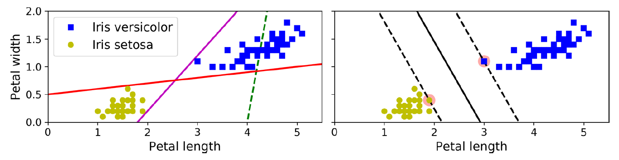
What is a Support Vector Machine (SVM)?
Goal = Widest Possible Street
How to choose the best decision boundary?
“Support Vectors”
Notes:
Supervised ML algorithm that learn a boundary, more generally a “street” from data for regression or classification

Slide 5
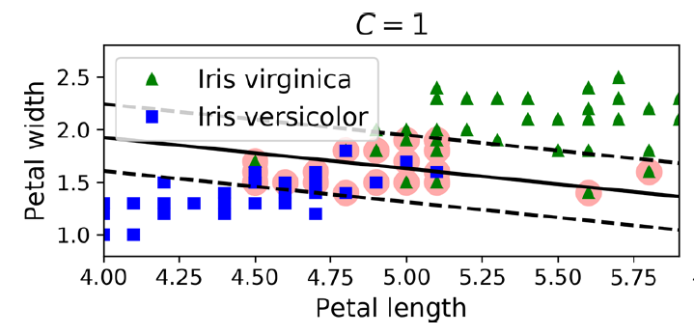

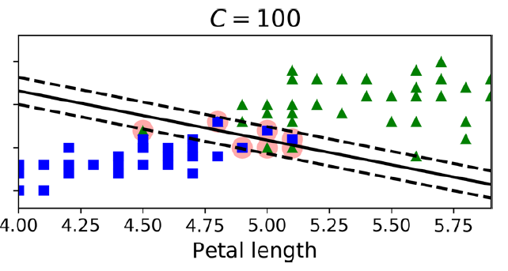
SVMs sorted by complexity/representation power
Reducing the hyperparameter C means that we tolerate more margin violations. This will bring about a smoother decision boundary, i.e., regularization of SVM model.
By reducing the C value, the model increases the street and accepts more margin violations. This means that it is less sensitive to outliers.
The hyperparameter C set up the margin violation, so the number of instances that end up on the wrong side of the classification. If we reduce C, there are more margin violations, but it will genaralise better and have less overfitting.
Linear SVM
(with soft margin)
Representation power/Complexity

Slide 6

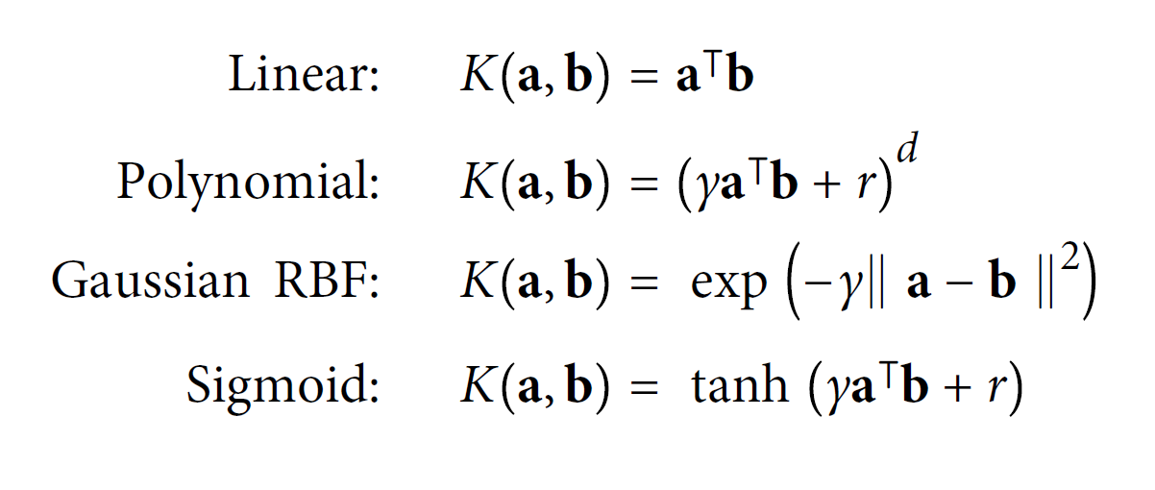

Can you elaborate on kernels?
Source: SVM with polynomial kernel visualization (Udiprod, Youtube)
Notes:
Point of the RBF

Slide 7
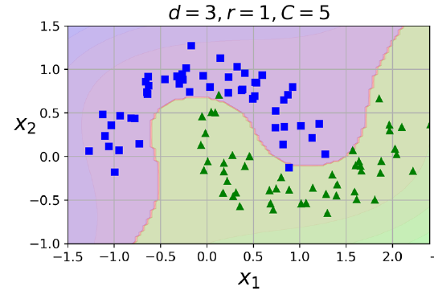
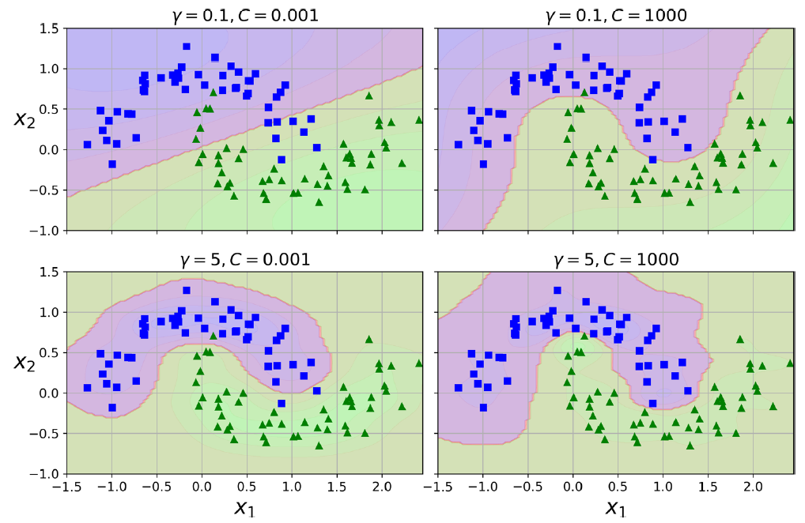
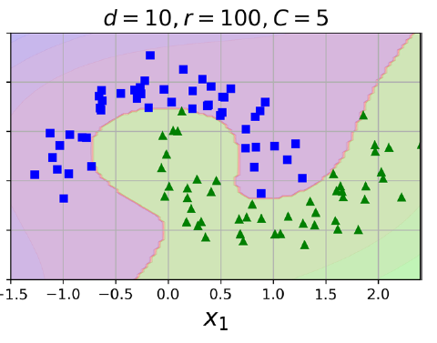
SVMs sorted by complexity/representation power
SVM with RBF kernel
Linear SVM
(with soft margin)
SVM with polynomial kernel
Representation power/Complexity
Notes:
Why would RBF kernel be useful?

Slide 8
Which complexity to choose for env. applications?
An example would be classifying water and vegetation pixels based on NDVI.
determining forest cover from its surrounding, only based on longitude and latitude.
When there is a clear difference between two groups, for exemple tree population over/under a decided altitude
Asses species environment (biomes, coordinates) based on many features such as physical characteristics, alimentation, behavior, ect..
differentiating cloudy and non-cloudy satellite imagery pixels in the open oceans
differentiate convective storms that produce hail and those that do not
Classifying linearly separable values e.g species differentiation by physiological characteristic
SVM with polynomial kernel
SVM with RBF kernel
Linear SVM
(with soft margin)
Representation power/Complexity
Notes:
For Intro to quadratic programming & online SVMs, see Géron Ch5

Slide 9
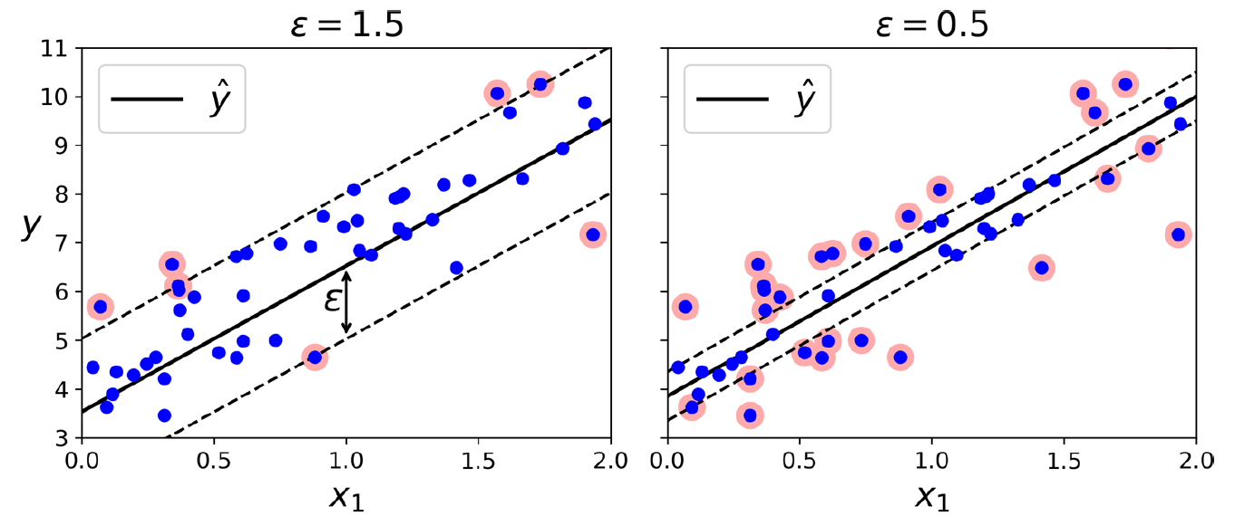
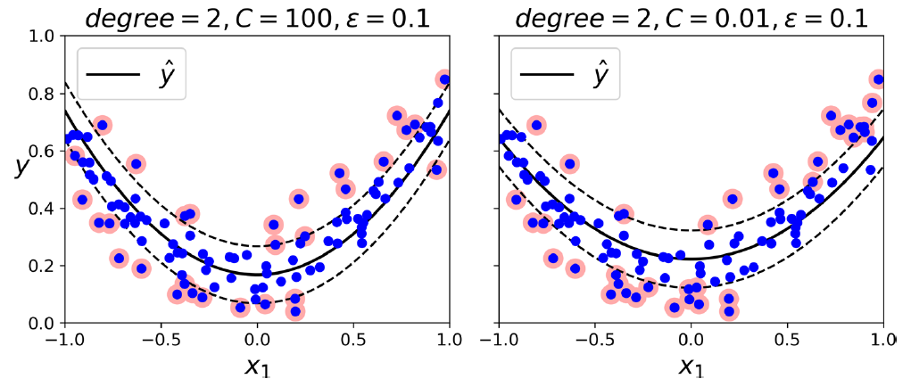
SVM Regression: Are wide margins a good thing of not?
Reverse the objective: Try to fit as many instances on the street while limiting instances off the street
Possible to use nonlinear kernels
Useful for detecting outliers
Problem for applications: Does not scale well with data size

Slide 10
Min 25-35: Decision Trees for Interpretable Classification/Regression
Learning Objectives (Géron Ch6):
Know how to train & interpret a decision tree
Understand how to choose a regularization hyperparameter

Slide 11
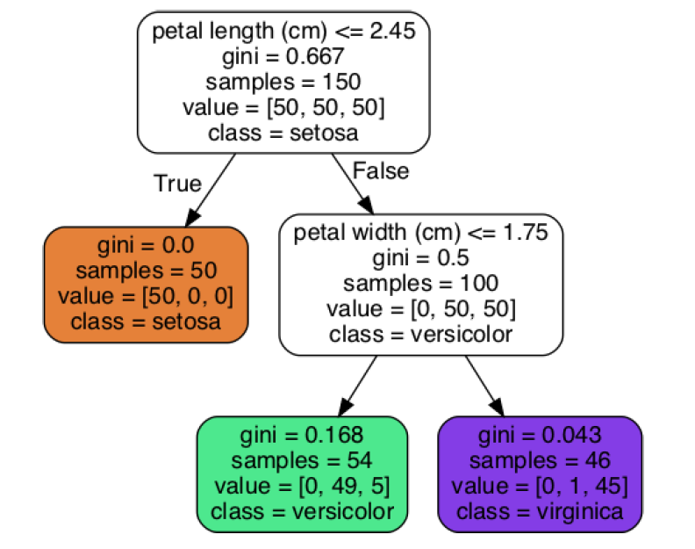
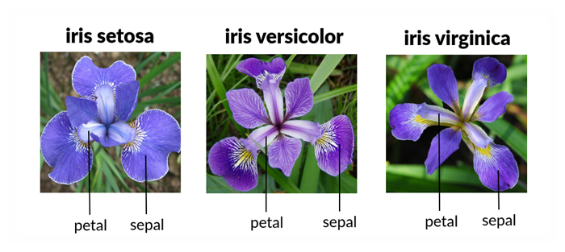

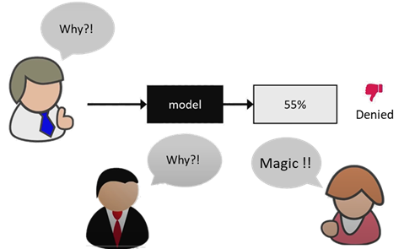
The advantages of a Transparent Model
Parents
Children

Slide 12
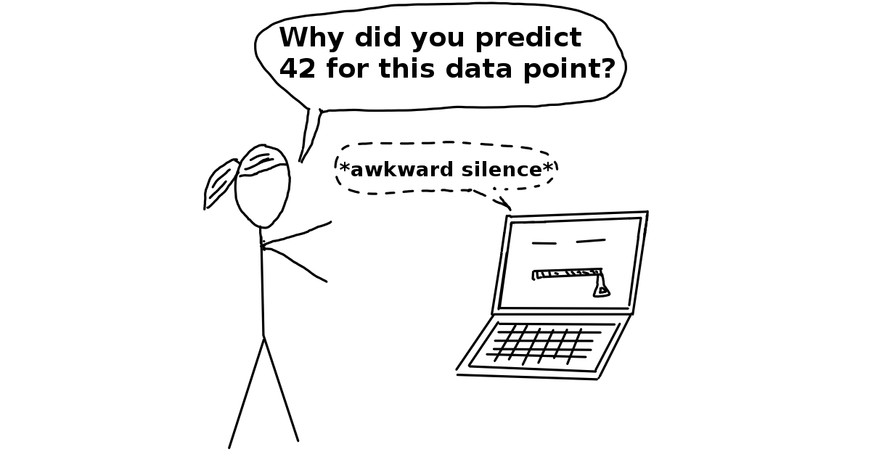
When do we need transparent models in env. sci.?
When we need interpretability
← ← ← ← ← ← ← ← ←
Environmental policy making
When the goal is to understand rather than to predict, for example classify sediment samples into groups of different origin with the goal to understand the influence of the different variables.
a phenomenon which requires clear comprehension after the prediction process. For instance, the application of a type of decision tree on a specific pixel type in satellite image to distinguish between vegetation and no vegetation.
Source: Interpretable ML (C. Molnar)

Slide 13


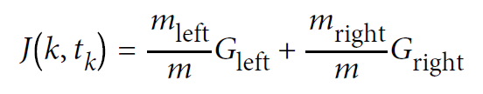
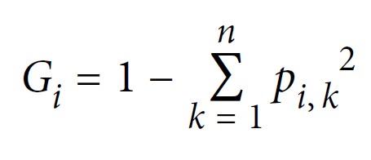
How can we train or “grow” a decision tree?
+
= ?
CART algorithm
Decision tree
min_samples_split
min_samples_leaf
max_leaf_nodes
max_features
Gini impurity:
Photos by: Bruno Kelzer, Johann Siemens
Notes:
Classification and Regression Tree
min_samples_split (the minimum number of samples a node must have before it can be split), min_samples_leaf (the minimum number of samples a leaf node must have), max_leaf_nodes (the maximum number of leaf nodes) max_features (the maximum number of features that are evaluated for splitting at each node)

Slide 14
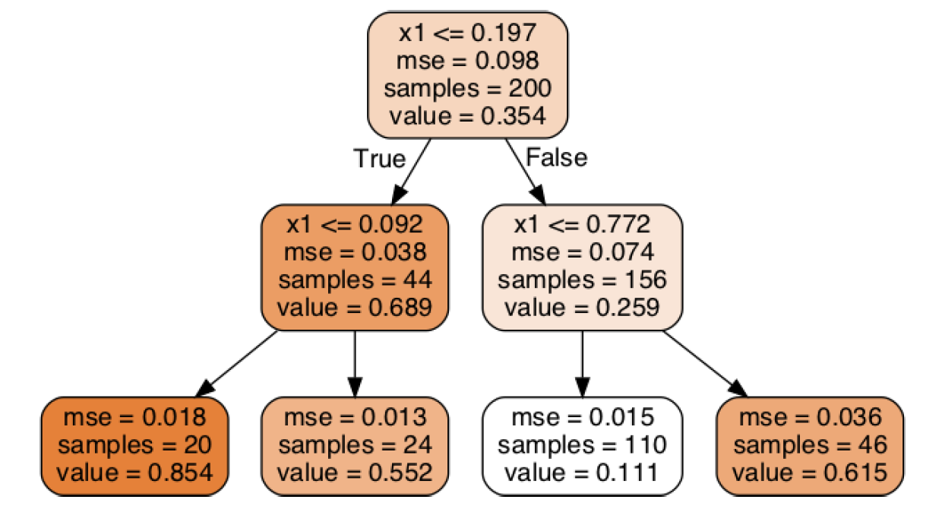
How can we train or “grow” a decision tree?
x1=0.7
+
=
Regression ≈ Nearest neighbor
CART algorithm
Decision tree
min_samples_split
min_samples_leaf
max_leaf_nodes
max_features
Gini impurity:
Supervised
Photos by: Bruno Kelzer, Johann Siemens
Notes:
m = Number of instances; QUICK VOTE
min_samples_split (the minimum number of samples a node must have before it can be split), min_samples_leaf (the minimum number of samples a leaf node must have), max_leaf_nodes (the maximum number of leaf nodes) max_features (the maximum number of features that are evaluated for splitting at each node)

Slide 15

How long does it take? Computational Complexity
Fast prediction ☺
At each node, compare:
All features
on All samples
Much slower training ☹
Photos by: Bruno Kelzer, Johann Siemens
Notes:
min_samples_split (the minimum number of samples a node must have before it can be split), min_samples_leaf (the minimum number of samples a leaf node must have), max_leaf_nodes (the maximum number of leaf nodes) max_features (the maximum number of features that are evaluated for splitting at each node)

Slide 16
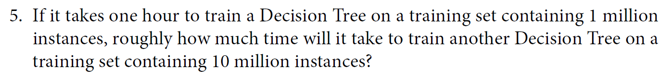
How long does it take: Computational Complexity
Notes:
min_samples_split (the minimum number of samples a node must have before it can be split), min_samples_leaf (the minimum number of samples a leaf node must have), max_leaf_nodes (the maximum number of leaf nodes) max_features (the maximum number of features that are evaluated for splitting at each node)
Vote

Slide 17
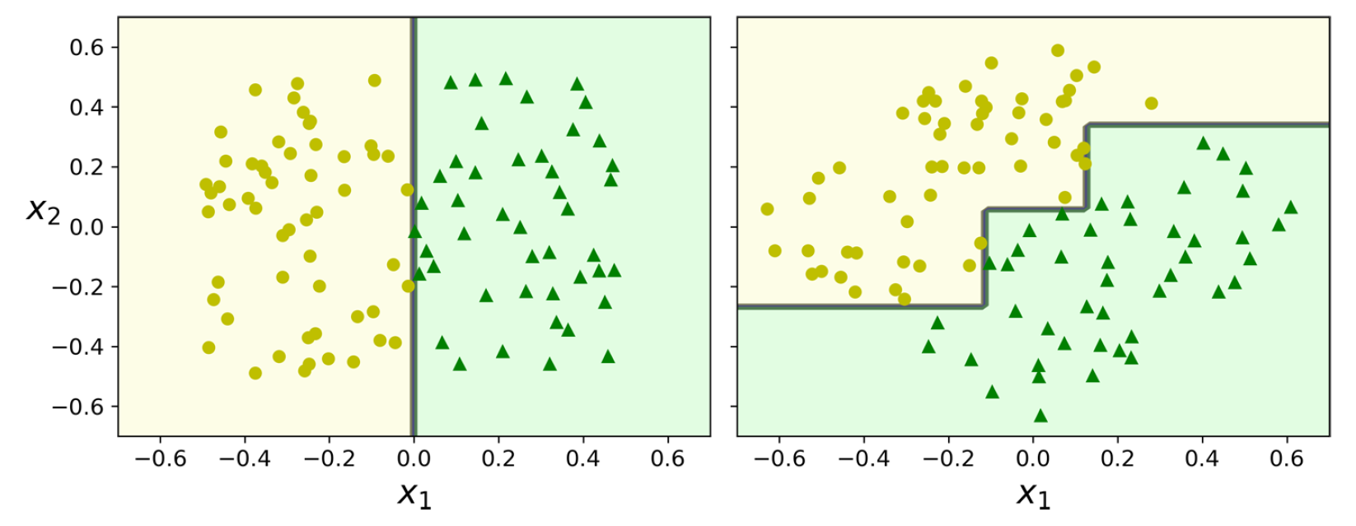
What are the steps to choose one ML method over another? how do we know whether a model will generalize well?
Use domain knowledge (how complex is the method vs env. problem?) & Characteristic of the datasets (data size ↔ complexity)
Pick a model and train it on the training set UNDERFITTING? Try a more complex model ☺
(Optional) Adjust its hyperparameters on the validation set
Evaluate on the test set (ideally a generalization set) OVERFITTING? Regularize your model or try a (simpler) model ☺
→ Workflow from lecture 1 slides or Géron Ch2/Appendix B for more

Slide 18
Min 35-45: Random Forests & Ensembles: The power of teamwork
Learning Objectives (Géron Ch7):
Define a random forest
Know some advantages/drawbacks of ensemble modeling
Understand feature importance

Slide 19
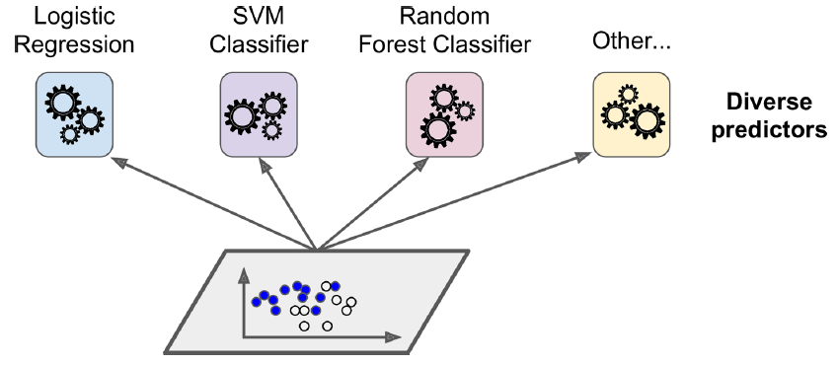
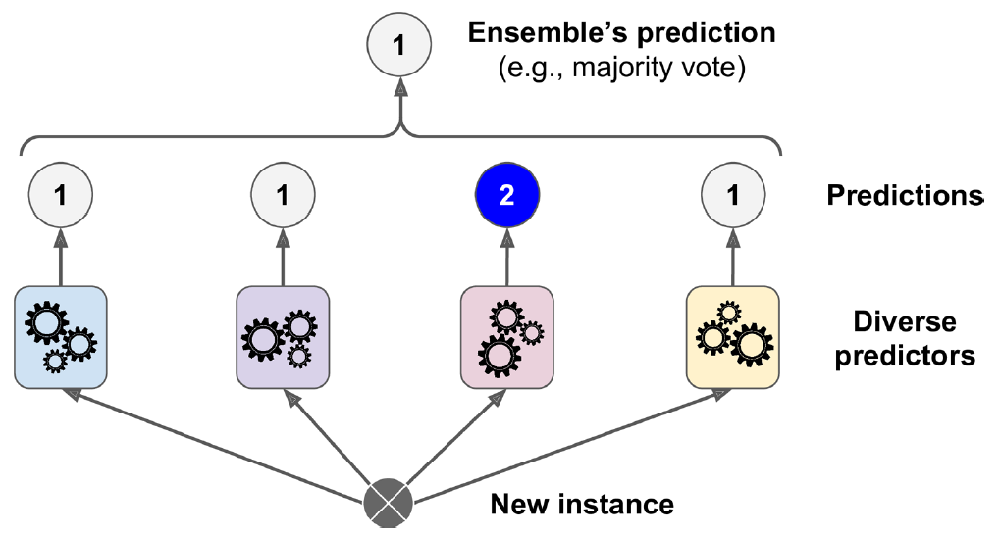
A random forest is an ensemble of decision trees
Step 1: Train an ensemble of different models
Many ways of creating ensembles
Step 2: Make the ensemble vote
Hard voting ≠ Soft voting

Slide 20
Advantages of ensemble modeling Q) Why choose random forest over decision tree?
Pros:
If models make different types of errors, ensemble usually more accurate
More representation power than individual models
Smoother predictions (less spread) → Increase in robustness
Uncertainty quantification
Probabilistic predictions
Cons (Q = Why not always train ensemble models?):
(1) Computationally expensive; (2) Less interpretable; (3) Can increase bias

Slide 21
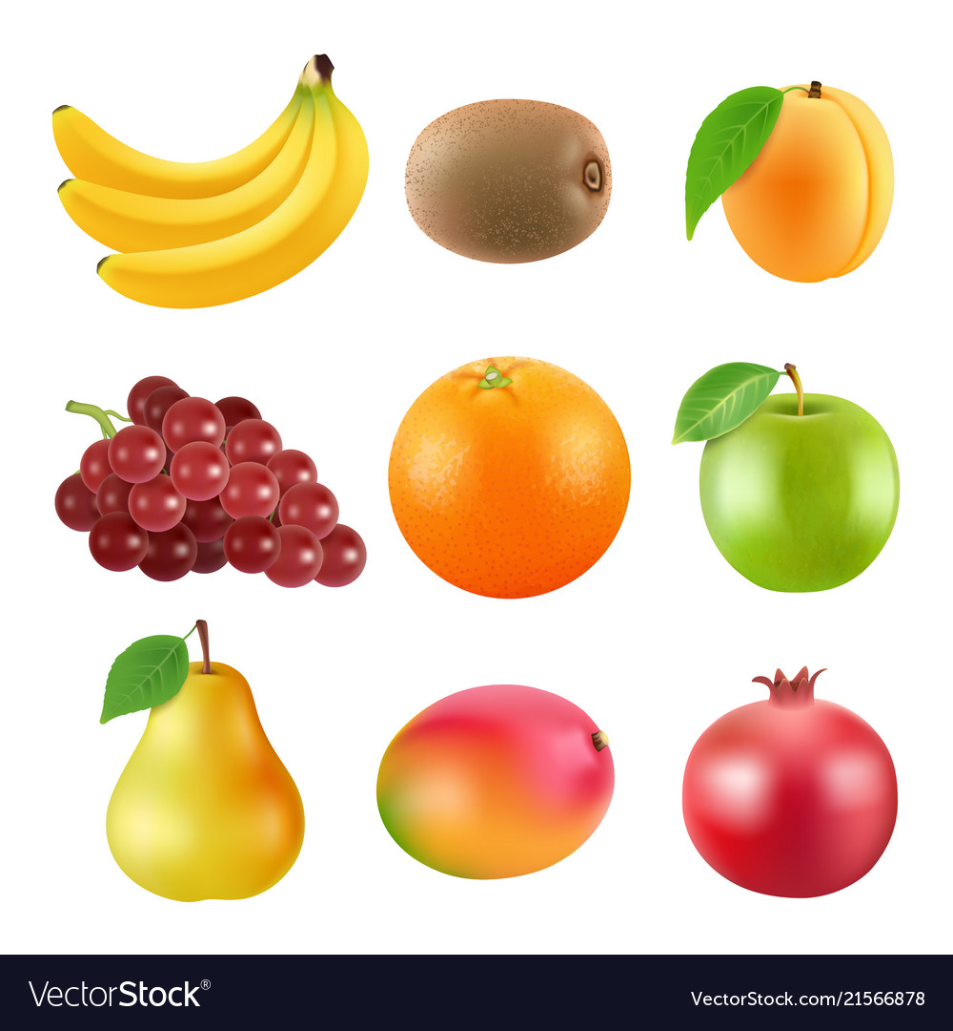
Bagging = Sampling with replacement Pasting = Sampling without replacement
Original Training Set
?→?

Slide 22
Bagging = Sampling with replacement Pasting = Sampling without replacement
Original Training Set
→
Notes:
Quick vote

Slide 23
Bagging = Sampling with replacement Pasting = Sampling without replacement
Original Training Set
→
Notes:
Quick vote

Slide 24
Bagging = Sampling with replacement (small data) Pasting = Sampling without replacement
Original Training Set
→
Notes:
Quick vote

Slide 25
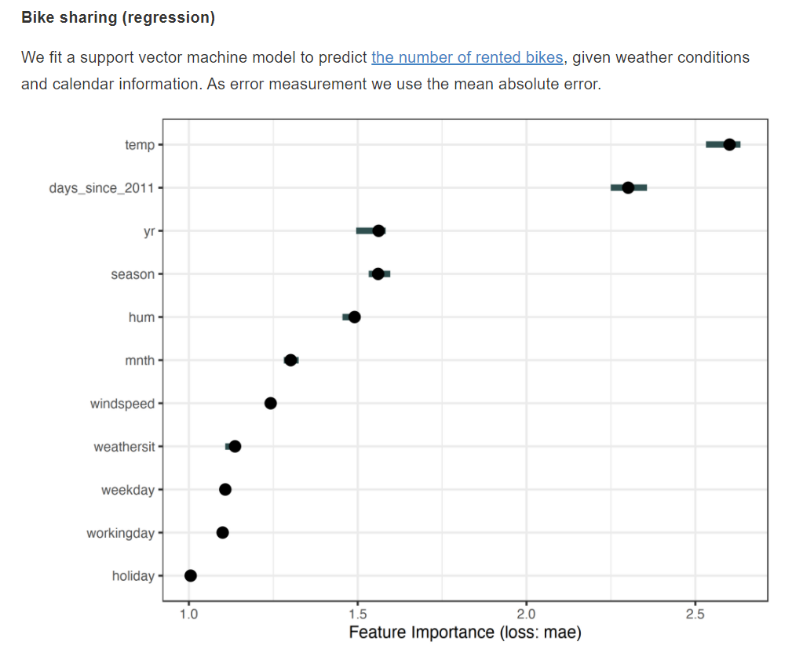
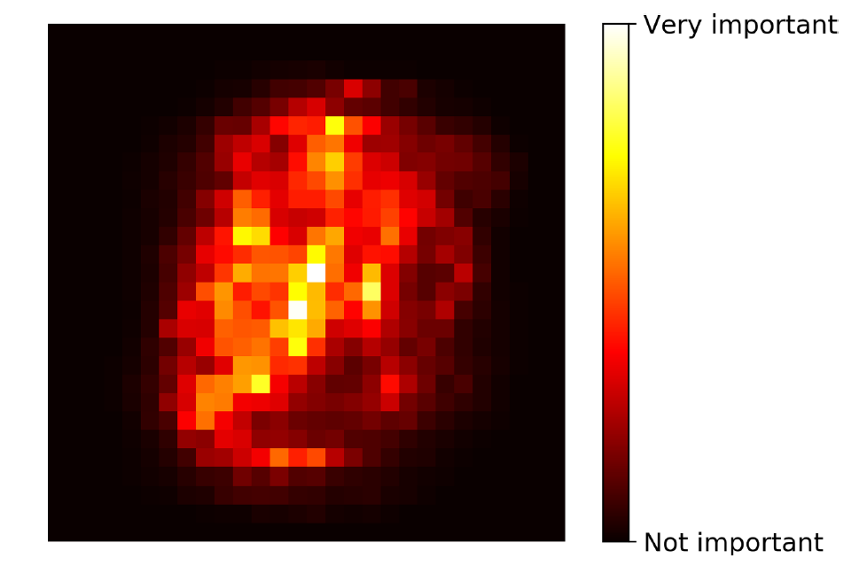
Feature Importance: Towards Interpretable Models
Random Forest: Sample-averaged decreased Gini impurity
Source: HOML2 (Géron), Interpretable ML (Molnar)

Slide 26
How to use feature importance in environmental Science?
When the computational or measurement cost is high, or when deciding what features to put in a model.
When predicting air pollution levels, knowing how the feature importance of different features (wind speed, wind direction, temperature) have on the prediction outcome.
How and which environmental factors influence vegetation dynamics in a particular context?
Finding which features are important/relevant to explain the widening of a river (large wood accumulation, precipitations, erosion, riparian vegetation ,etc, )
It would be useful if we try to quantify the impact of more than two pollutant. So we can see which one will be more dangerous.
The feature importance can give a better understanding of an environmental problem which can lead to improve the modeling process by focusing on those important features
Determining which morphological aspects influence species classification, or which considerations influence the danger class of a natural hazard.
When developing a rainfall generator for cities for which many features are available and you want to know which ones will modify most the precipitation e.g. heat island, pollution sources, building geometry…
When we want to reduce the number of features.

Slide 27
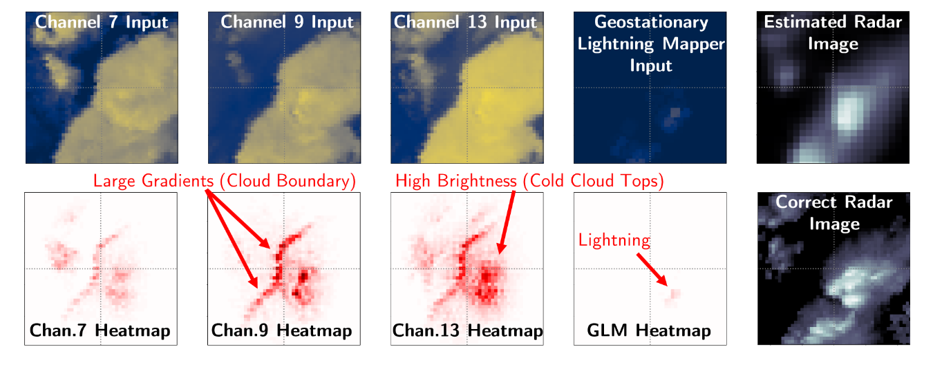
How to use feature importance in environmental Science?
Source: Ebert-Uphoff and Hilburn (2020)
Notes:
Use of an attribution method, namely Layer-Wise Relevance Propagation (LRP),to analyze a neural network model that seeks to translate imagery from the Geostationary Op-erational Environmental Satellite into Multi-Radar Multi-Sensor (MRMS) imagery. LRP results(bottom row) showwherein the input channels the neural network is focusing when predict-ing the MRMS value for a single (central) pixel. Using LRP indicated for various samples threestrategies for the neural network to trigger large MRMS values, namely i) cloud boundaries, ii)cold cloud tops, and iii) presence of lightning in the Geostationary Lightning Mapper channel.

Slide 28
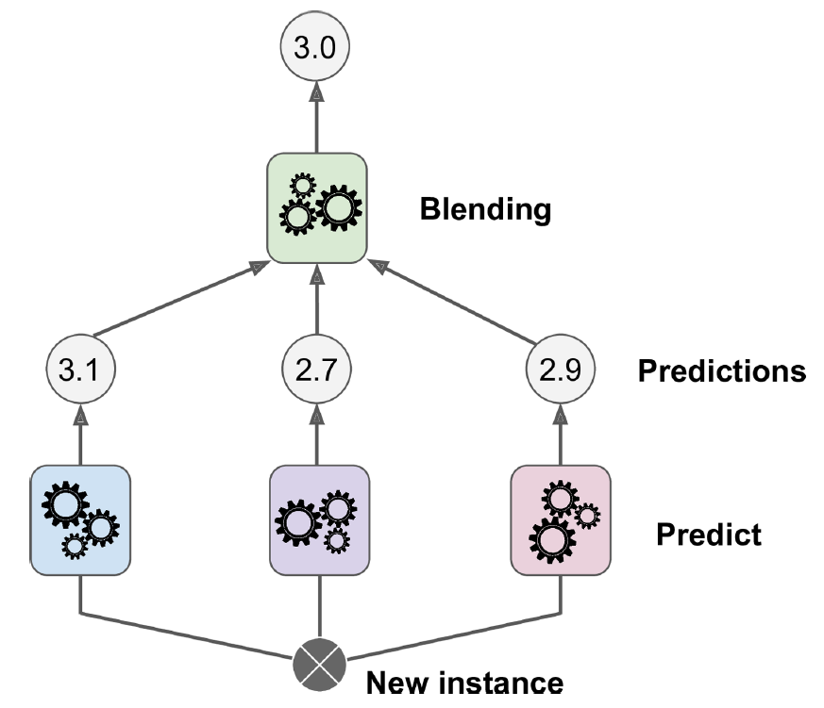
Stacking (Stacked Generalization) and Blending
What if model 2 is always bad in situation X? And model 3 is always bad in situation Y?

Slide 29
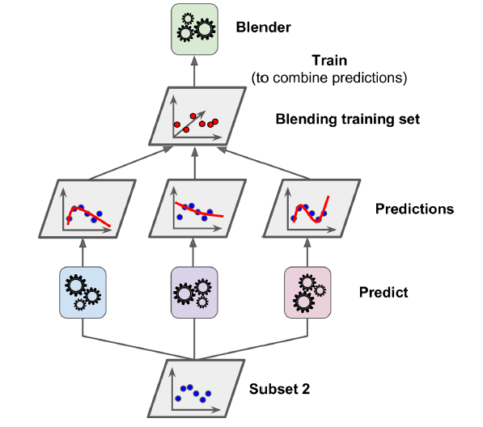
Stacking and Blending

Slide 30
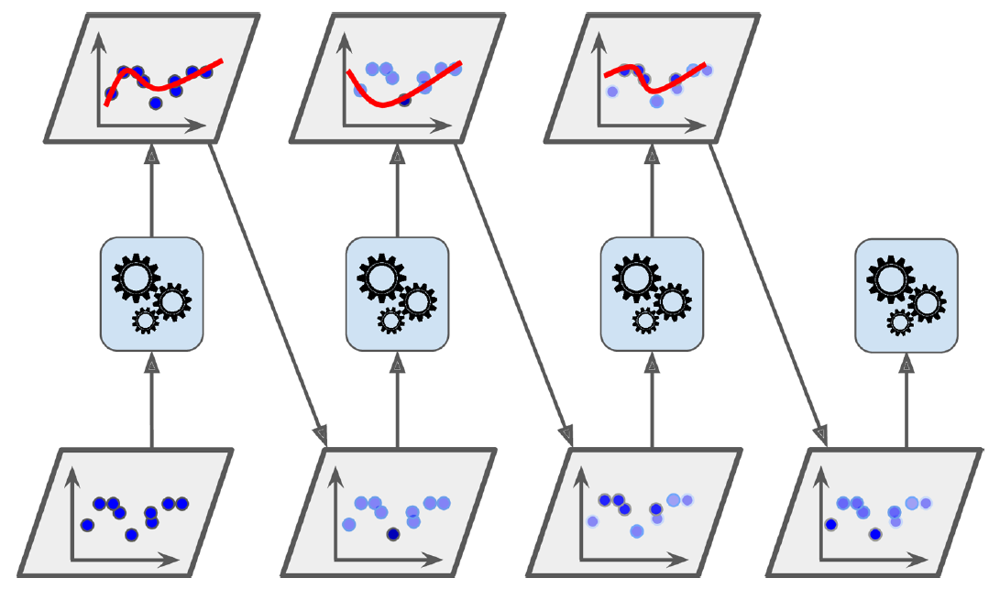


Boosting = Combining weak learners into strong one by sequentially correcting preceding predictions
AdaBoost: Increase weights (misclassified)
Grad. Boosting: Train on resid.

Slide 31
Min 45-60: Moodle Quiz (5 questions, 15 min) ⚠️ The quiz has 2 pages ⚠️
Learning Objectives (Moodle Quiz at Min 45 on Géron Ch5+6+7):
Name Support Vector Machines & understand their applicability
Know how to train & interpret a decision tree
Understand how to choose a regularization hyperparameter
Define a random forest
Know some advantages/drawbacks of ensemble modeling
Understand feature importance
Notes:
Questions?
Not graded

Slide 32

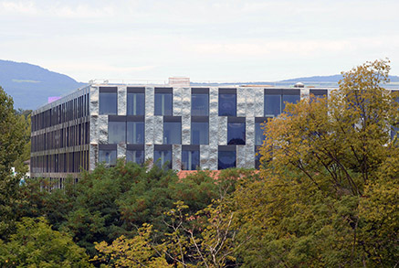
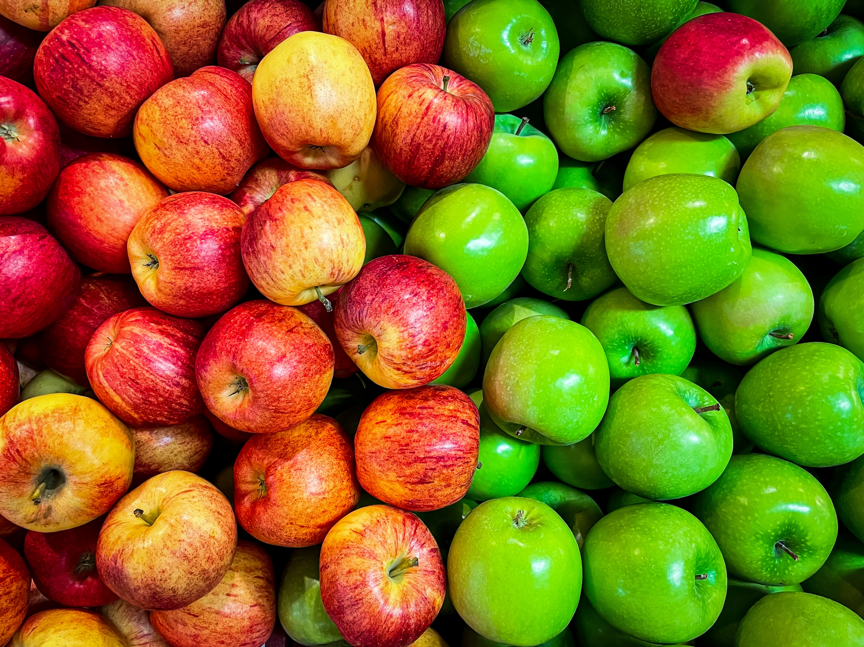
Min 60-75: Break

Slide 33

Min 75-110: Susceptibility mapping of Environmental Hazards using ML
Image
Re-read the article and write down (1) the scientific goal of the paper; (2) One simple question with your neighbor. Example: What is a susceptibility map?
Image Source: edb3_16

Slide 34
According to past data, which locations of the Liguria region are most susceptible to wildfires?
Problem: - Traditional susceptibility maps are not informed by data
- Statistical models only use a few years & do not separate by seasons
Idea: Train random forest to detect wildfires for 21y & use resulting probab.
Result: Susceptibility map indicating likelihood of wildfire events

Slide 35
Questions
Is machine learning also commonly used to predict landslides, avalanches, rockslides, mudslides, floods and tidlewaves ?
Know that the susceptibility is mapped, how can we use it to prevent the wildfires ?
How does the amount of time spent implementing a ML algorithm for susceptibility mapping compare to time spent on traditional susceptibility mapping methods (ie. physically based models integrated into GIS)?
I didn't understand well the manipulation with the k-fold cross validation.
this study was done in a region in Italy- would it be easy to use it to predict susceptibility in other areas/has it been used in other areas of the world and how big of an area could it be used on at once?
can you explain question 4.2 please?
Could you have done a paper like this and come up with the same results without machine learning?
Did you test the model with spatial blocks of different sizes ? What is the result and why 15km by 15km.
Do you enjoy machine learning ?
How easily can this method be transformed into other natural hazards, like avalanches?
the comparison is interesting on the figure 4, but since the probability of fire should be way higher in the summer, shouldn't we adapt both graphs and express this greater risk?
What are the main questions related to the choice of the different model
Did this map was finally used by firefighters department in the studied region ?

Slide 36
Questions
Is this model also valid for others country or a new model has to be create again each time ?
Why was the data collected over a large time period , i,e., spanning a 21-year period (1997–2017). Would it have being better or worse to have less or more dataset temporally?
-
how wildfires evolved since 2017 and are they coherent with the maps?
No more time
Were these susceptibility maps effectively used by the Italian Fire fighters ? Did it show an important improvement in their fire fighting strategy?
Have you any post-2017 data to assess the evolution of wildfire management since then?
How do you decide on your parameters while making the susceptibility maps.
what's the advantage of using an increasing number of folds in the k-folds cross-validation in that study?

Slide 37
Min 110-120: Review Moodle Quiz
Learning Objectives (Moodle Quiz at Min 45 on Géron Ch5+6+7):
Name Support Vector Machines & understand their applicability
Know how to train & interpret a decision tree
Understand how to choose a regularization hyperparameter
Define a random forest
Know some advantages/drawbacks of ensemble modeling
Understand feature importance
Notes:
Questions?
Not graded

Slide 38
Start thinking about your final project and book a one-on-one meeting
The final project’s goal is to answer a well-defined scientific question by applying one of the ML algorithms introduced in class on an environmental dataset of your choice (e.g., related to your Masters thesis or your PhD research).
Can you think of a large environmental dataset linked to a scientific question you are passionate about?
In the affirmative, how could you format the dataset to facilitate its manipulation in Python?
In the negative, consider browsing the list of benchmark datasets maintained by Pangeo (http://mldata.pangeo.io/index.html), Kaggle, or browse the class syllabus’ datasets
Notes:
Questions?

Slide 39
Question 3.3
Training Set
Validation Set
Test Set
Accuracy before decreasing complexity
0.92
0.51
0.56
Accuracy after decreasing complexity
0.21
0.15
0.18
Notes:
Know how to benchmark a regression model

